Slide 1
Side Scroller Game Demo
By Richard Romano, Ryan Fallis,
& Keerthan Nayak
Notes:
-Ryan

Slide 2
Project Overview
Hardware
Rojobot Controller
Rojobot IP Block
BotSim31 Picoblaze Core
Software
Results
Team Contributions
Notes:
-Ryan

Slide 3
Rojobot Controller
Modifications
Notes:
-Ryan

Slide 4

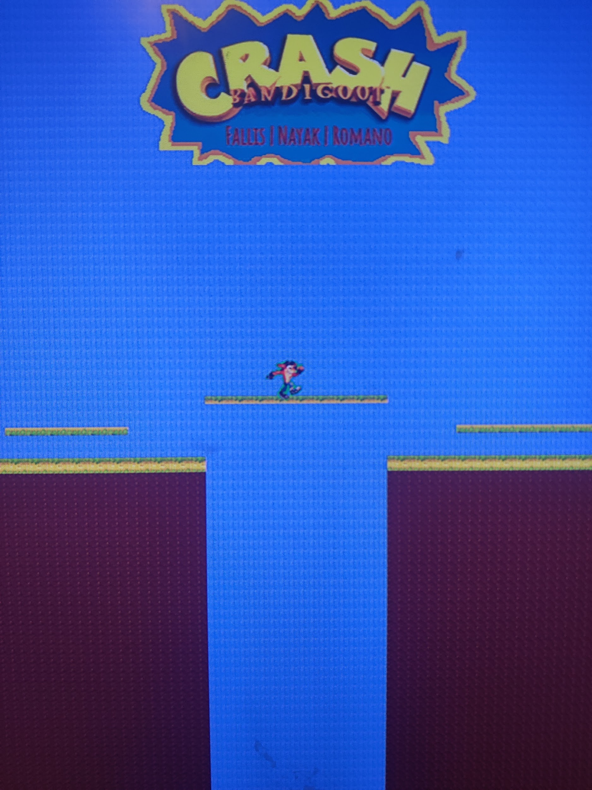
Map Design
Used BOTWORLD Dev Kit to make custom maps
Edited 128x128 text file
Converted to .coe file using perl script
Hijacked worldmap block memory for new maps
Notes:
-Ryan

Slide 5
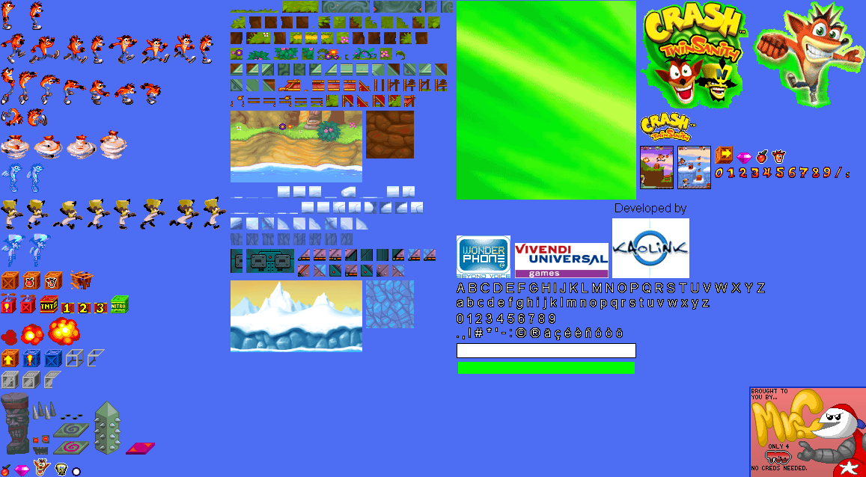
Icon Design
Sprite sheet
Reverse-engineering Pikachu
MS Paint
Matlab
Notes:
-Ryan

Slide 6

Title Design
Used sprite sheet and MS Paint to customize the image
Used online software tool to add in our names with stylish font
Converted to hex values with Matlab and used title_colorizer.v ram block to store file
Notes:
-Ryan

Slide 7
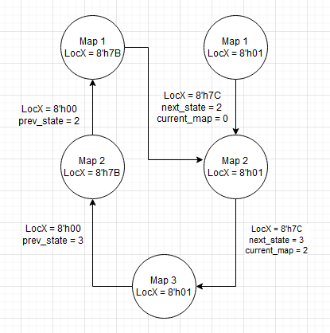
Map Mux
Needed to switch between maps in both forward and reverse directions
Implemented a mux and always block that functioned as a state machine
Notes:
-Ryan

Slide 8
Rojobot IP Block
Modifications
Notes:
-Ryan

Slide 9


Jumping & Falling
Bot jump shifts icon pixels 4 pixels up
Falling shifts bot 1 pixel down while not on a black line and in motion
Modified bot31_if.v to implement jumping/falling mechanics
Timer will quickly return a jumping bot back to origin
Notes:
-Ryan

Slide 10
Teleport (Map Transitioning)
First modified interface to intercept the LocX & LocY registers so that we could override them.
Added in overrides for end and start of screen.
Teleport works concurrently with map muxer for a smooth bi-directional transition.
Notes:
-Richard

Slide 11
BotSim31 Picoblaze
Core Modifications
Notes:
-Richard

Slide 12

Initial Changes
Adjusted Starting LocX to h01.
Added LocX/LocY input ports to override.
Re-assembled using KCPSM6 application.
Notes:
-Richard

Slide 13
Re-mapping of Controls
Originally robot would stop and slowly rotate, which isn’t very video game like.
Left Button = Forward + Orient West
Right Button = Forward + Orient East
L&R Button = Forward + Orient North (Jump)
T&B Button = Reverse + Orient North (Down)
Notes:
-Richard

Slide 14
Software

Slide 15
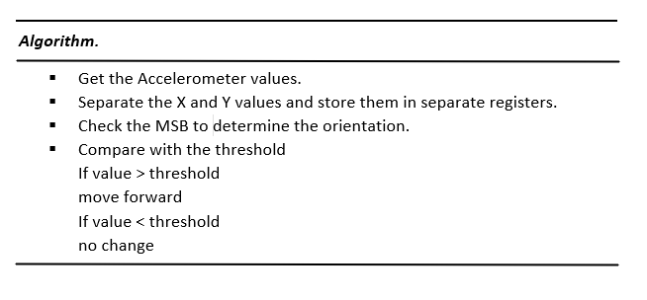
Algorithm

Slide 16
Accelerometer Mapping
The Accelerometer returns a value of 12 bit resolution.
If X-axis is negative
Change bot orientation to North
If X-axis is positive
Change bot orientation to South.
If Y - axis is positive
Change bot orientation to West.
If Y - axis is negative
Change bot orientation to East.
Notes:
-KEERTHAN

Slide 17
Accelerometer Testing
Accelerometer values were printed on the seven segment display to verify the output of the accelerometer.
The bot was controlled using the accelerometer to ensure that it is functioning as expected.
Notes:
-KEERTHAN

Slide 18
Accelerometer Sensitivity
The accelerometer is very sensitive to small movements.
Multiple axis may need to checked to control the bot.
Various Values of threshold may be required for different axis.
Notes:
-KEERTHAN

Slide 19
Results
Notes:
-Richard

Slide 20
Successes
Teleport - Rebuilding the BotSim core successfully the first time was satisfying.
Muxing - able to successfully switch between maps when moving in the forward and reverse direction.
Icon - Crash Bandicoot icon looks good.
Remapping Movement - Took quite awhile to figure out a scheme that worked and wasn’t crazy hard to implement but we are happy with our final choice.
Notes:
-Richard

Slide 21
Failures
Bigger map size - Everything is pretty hard coded to only accept maps of 128x128.
Modifying MotCtl - turned mostly into a disaster due to how pretty much the entire robot was built on the variable speed left/right motor setup.
BotSim lookup tables - All of the lookup tables build off of each other so it was quickly turning into a lot of non-working spaghetti code.
Making obstructions impassible - The robot always finds a way.
True side scrolling - After the first week in the project we determined we would have more success having the game function more like super mario where the bot moves as opposed to the map moving like a traditional side scroller.
Wumpa Fruit - wanted to include the classic Crash Bandicoot fruit as a power up option that would increase the bot’s speed for a short duration but wasn’t able to meet this stretch goal in time.
Notes:
-Richard

Slide 22
Team Contributions
Ryan
Map Design
Icon Design
Title Design
Map Muxing
Jumping/Falling
Richard
Map Muxing (Module)
BotSim31 Modifications
Teleport
Control Re-Mapping
On-Black-Line Movement
Assembly T/S
Keerthan
Accelerometer
Notes:
-Richard

Slide 23
Thank You
-Side Scroller Team
Notes:
-Richard

